Slide 1


Important points regarding ITR Filing and changes relevant to the current year (AY 2024-25)
JUNE 15, 2024
PRESENTED BY: MEENAKSHI RATHI
MENTORED BY: RUCHIKA RANA

Slide 2


Topic Description
Common points to be kept in mind going forward while preparation of COI and execution of ITR DCLs (Part B, Part C and Part D) and filing ITR form.
vkalra.com

Slide 3


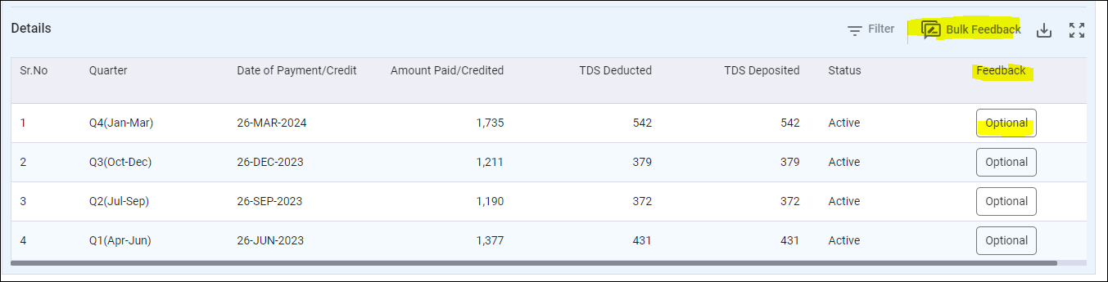
Common points for preparation of COI
1. Ensure matching TDS/TCS credit from AIS, TIS and 26AS
In case there are any differences or discrepancies w.r.t the details of income/expenses as per AIS/TIS and books of accounts, please ensure to file response/feedback at compliance portal to avoid receipt of notice under section 133(6) and 133C of the ITA.
vkalra.com

Slide 4
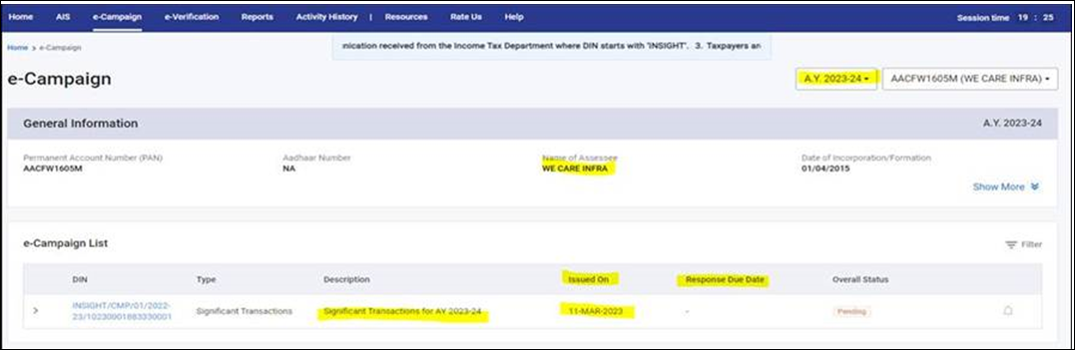
Common points for preparation of COI
2. Response /Feedback is mandatory to be filed
Please ensure to file the response/feedback at portal.
vkalra.com

Slide 5
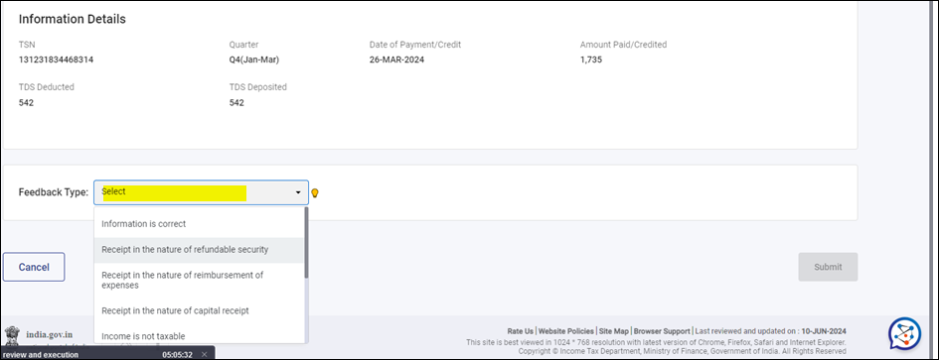
Common points for preparation of COI
2. Response /Feedback is mandatory to be filed
Please ensure to file the response/feedback at portal.
vkalra.com

Slide 6
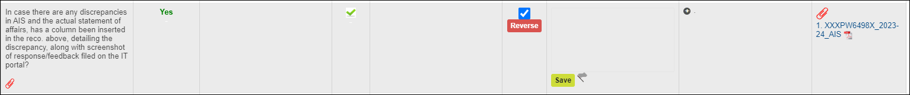
Common points for preparation of COI
3. Response /Feedback is mandatory to be filed
Please ensure to attach the snip of the response filed in the ITR DCL Part-B. Do not provide irrelevant attachments.
vkalra.com

Slide 7
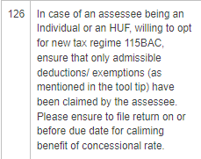
4. No clarity regarding opting for old regime or new regime
A single regime needs to be followed and the same needs to be mentioned in COI. Please ensure to mention that correctly.
vkalra.com

Slide 8
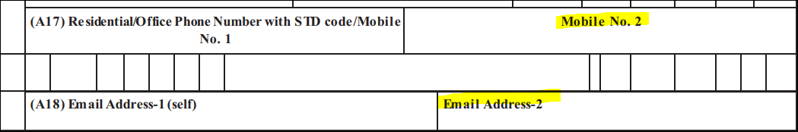
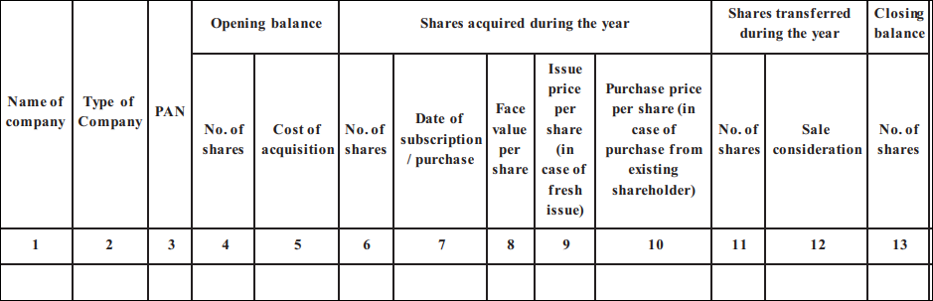
Common errors in filing of Income Tax Return
5. Mandatory information that should be present in General schedule tab.
Mention office contact details in secondary contact details option as mentioned in tooltip
Closing balance of unlisted shares held by the client (if any).
vkalra.com

Slide 9
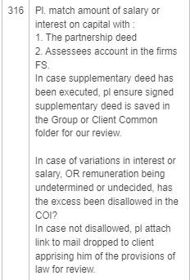
6. Supplementary deed not provided by the client to verify the remuneration amount given to partners
vkalra.com

Slide 10
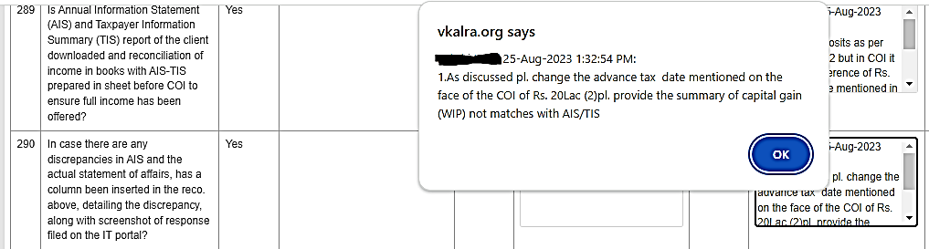
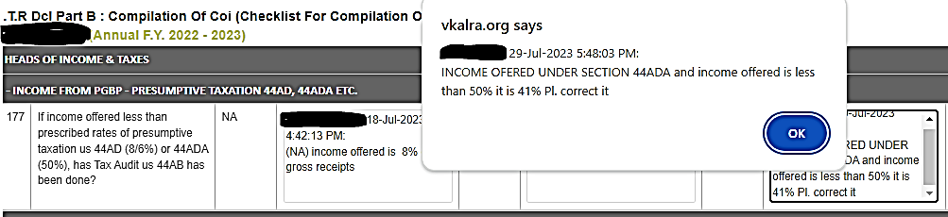
7. Common mistakes while preparing COI
Incorrect advance tax deposit date mentioned on the face of the COI.
Incomes are reflecting in capital account but are not offered in COI.
Income offered less than 8% (in case of business) and 50% (in case of Professions) if opting for 44AD and 44ADA, respectively.
vkalra.com

Slide 11
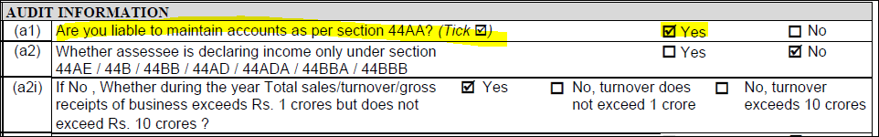

8. Bank Validation for issuance of refund.
Liable to maintain books of account as per section 44AA to be selected correctly.
In case, income from partnership firm, is the only income under PGBP, punch business code as 00001 i.e., Share of Income from firm only.
vkalra.com

Slide 12
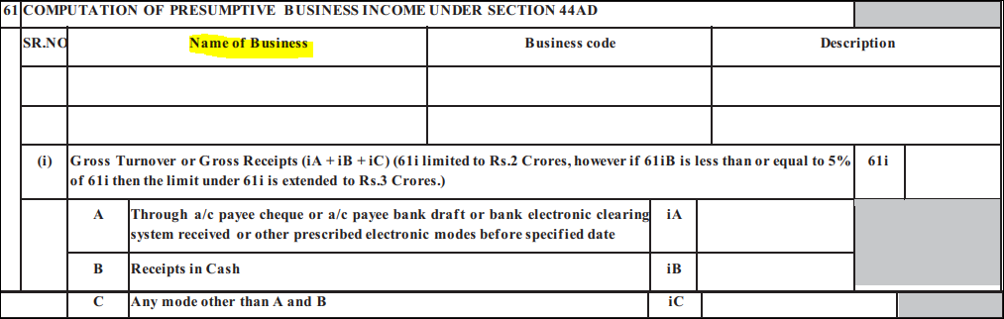
9. In case of Income under 44AD/44ADA/44AE, punching of business name.
Do not mention clients name under business name, if business name is not there, kindly put dash.
vkalra.com

Slide 13
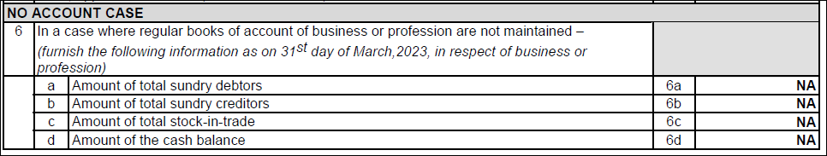
10. In case of Income under 44AD/44ADA/44AE, reporting of cash in hand is mandatory
Ensure to punch cash in hand amount in no account case to avoid receipt of defective notice under section 139(9) of ITA.
In case there is no cash, please punch minor amount.
vkalra.com

Slide 14
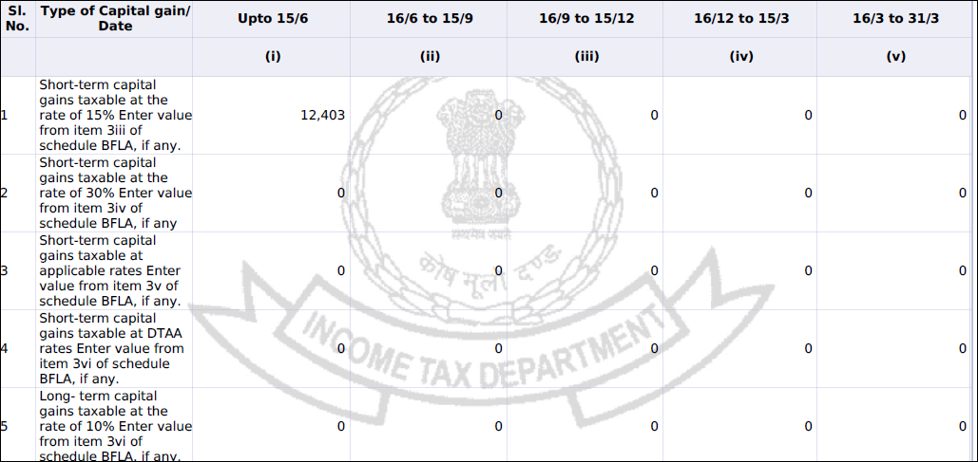
11. Other Common points.
Ensure to provide/punch bifurcation for dates of accrual/receipts of income from capital gain and dividend income quarter wise in ITR form.
vkalra.com

Slide 15
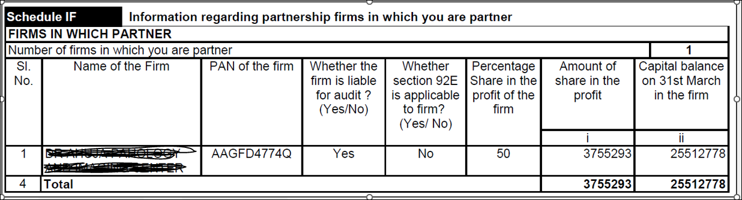
12. Information that was mostly missing in Schedule - IF
Details of closing capital balance and profit/loss from firm to be reported in Sch. IF.
Whether the firm was liable to audit or not.
Closing capital balances of partnership firm not reported in Sch. IF
vkalra.com

Slide 16
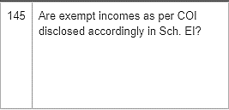
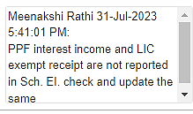
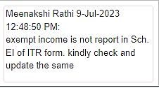
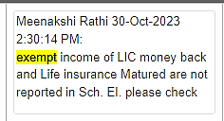
13. Exempt incomes not reported in Schedule - EI
vkalra.com

Slide 17
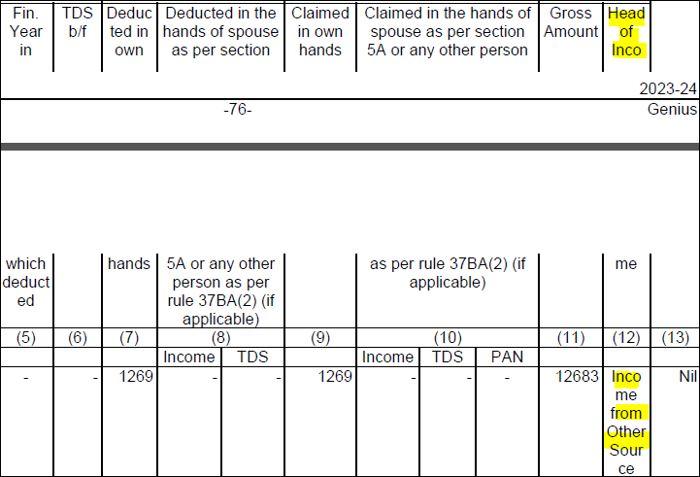
14. Correct details of TDS claimed to be reported in ITR Form.
Ensure to select correct head of income where the corresponding receipts on which TDS has been deducted reported/ punched otherwise partial credit of TDS claim will be allow by department at the time of processing of the return.
vkalra.com

Slide 18
15. Reasons for claiming excess or no TDS, not mentioned in DCLs
If TDS is deducted on the sale of immovable property and the deduction is made in the name of one person, but the claim is to be shared between two people, please enter the details in Schedule TDS. Indicate that 50% of the TDS is to be claimed by the other person and provide their PAN number in the schedule.
vkalra.com

Slide 19
16. Ensure that any exemptions claimed in the previous years under sections 54, 54B, 54EC, 54F, etc., have met the necessary conditions?
If any conditions are overlapping or expiring, ensure that the impact of these conditions is considered in the current year's computation of income (COI).The Exemption claimed earlier can be withdrawn in case condition mentioned as under are not fulfilled:
1. Under Section 54, 54B, 54F etc. of the Income Tax Act, an individual or HUF selling a residential/commercial/agricultural property can avail tax exemptions from Capital Gains if the capital gains are invested in purchase or construction of residential/commercial/agricultural property. The exemption will be withdrawn in case the newly purchased constructed property/land or property/land is transferred before the expiration of 3 years period of its construction or purchase and the same will be taxable under the long-term capital gain of the last year wherein the new asset is being transferred.
vkalra.com

Slide 20
2. In case any amount is deposited in capital gain account scheme then the amount deposited in an account under capital gains accounts scheme has to be utilized, in the case of purchase of new house/land, within two years after the date on which the transfer of the old house took place, and in the case of construction of a new house, within three years after the date on which the transfer took place. If the amount deposited under CGA scheme is not utilized in full within the time specified for the purchase/ construction of the new house/land, then the unutilized amount will be chargeable to tax under the head ‘Capital gains’ as the income of previous year in which the period of three years from the date of the transfer of the old house expires.
vkalra.com

Slide 21
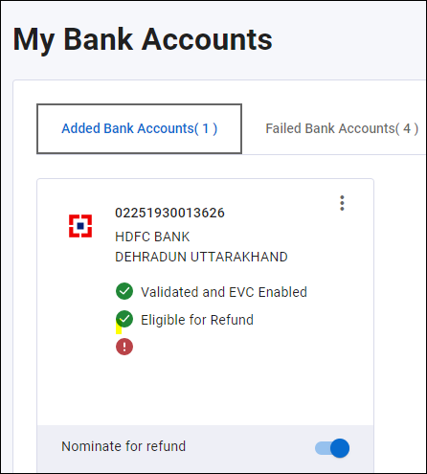
17. Bank Validation for issuance of refund.
Ensure that the bank is pre-validated.
Failure of refund in absence of correct validation of bank account.
vkalra.com

Slide 22
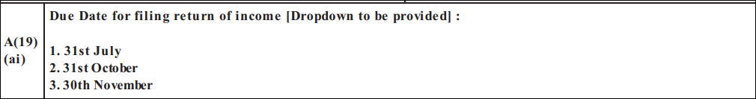
Changes in ITR w.r.t current AY 2024-25.
An additional column has been incorporated in the ITR Forms 3,5 and 6 to capture details about the deadline for submission. Taxpayers are now prompted to indicate the relevant due date for filing the return by selecting from the dropdown menu, which includes options such as July 31st, October 31st, or November 30th.
vkalra.com

Slide 23
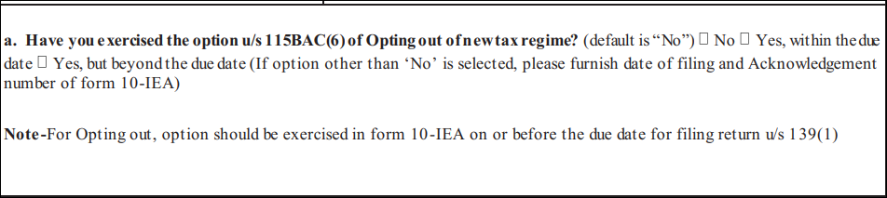
Changes in ITR w.r.t current AY 2024-25.
In case of an assesse being an Individual or an HUF, willing to opt for old regime, ensure admissible deductions/ exemptions have been claimed by the assessee. Please ensure to file form 10 IEA on or before due date for claiming the benefit, even if return is filed after due date.
vkalra.com

Slide 24
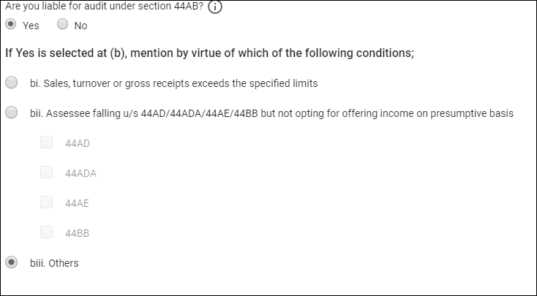
Changes in ITR w.r.t current AY 2024-25.
The new Income Tax Return (ITR) Forms 3, 5 and 6 require additional details from the assessee subjected to audit under Section 44AB.
vkalra.com

Slide 25
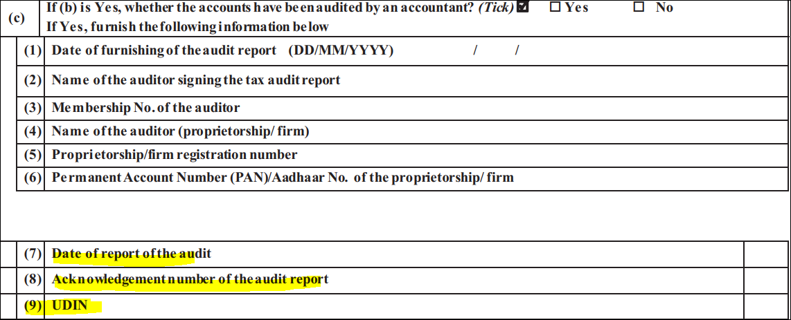
Changes in ITR w.r.t current AY 2024-25.
UDIN and Acknowledgement Number of the Audit Report to be reported in ITR form.
vkalra.com

Slide 26
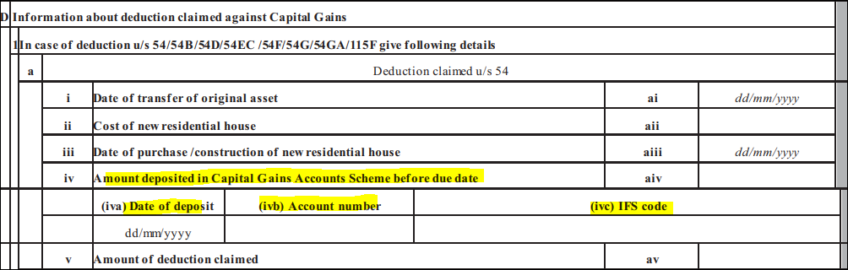
Changes in ITR w.r.t current AY 2024-25.
Now additional details pertaining to the Capital Gains Accounts Scheme if any balance deposited duly punched in ITR form are required to be reported as per snip enclosed.
vkalra.com

Slide 27
Changes in ITR w.r.t current AY 2024-25.
In case assesse is recognized as MSME details related to same is to be punched in general schedule tab.
vkalra.com

Slide 28
Prevention of double deduction claimed on interest on borrowed capital for acquiring, renewing, or reconstructing a property.
Under the existing provisions, the amount of any interest payable on borrowed capital for acquiring, renewing, or reconstructing a property is allowed as a deduction under the head “Income from house property” u/s 24. Section 48 provides that the income chargeable under the head “Capital gains” shall be computed, by deducting the COA of the asset and the COI thereto from the Full value of consideration received or accruing as a result of the transfer of the capital asset.
vkalra.com

Slide 29
Prevention of double deduction claimed on interest on borrowed capital for acquiring, renewing, or reconstructing a property.
It has been observed that some assessee’s have been claiming double deduction of interest paid on borrowed capital for acquiring, renewing, or reconstructing a property. Firstly, it is claimed in the form of deduction from income from house property u/s 24, and in some cases the deduction is also being claimed under other provisions of Chapter VIA. Secondly while computing capital gains on transfer of such property this same interest also forms a part of COA or COI u/s 48.
To prevent this double deduction, a proviso after Section 48(ii) has been inserted to provide that the COA/COI shall not include the amount of interest claimed u/s 24 or Chapter VIA.
vkalra.com

Slide 30
Rationalization of exempt income under life insurance policies.
According to 6th proviso to Section 10(10D)exemption will not apply with respect to any life insurance policy/policies (other than a unit linked insurance policy) issued on or after the 01-04-23, if the amount of premium in aggregate payable for any of the PY during the term of such policy exceeds INR 5 lacs.
Ensure that the aggregate amount of premium paid by a person for more than one life insurance policy (other than unit linked insurance policy), issued on or after the 01-04-23, for any life insurance policy (other than a unit linked insurance policy) does not exceed INR 5 lacs in any of the PYs during the term of any of those policies, if the premium exceeds the same will be taxable.
vkalra.com

Slide 31
Taxpayers, including individuals and HUFs, subject to audit requirements, have the option to verify their ITR using the EVC:
Amendments to Rule 12 now empower individuals and Hindu Undivided Families (HUFs) subjected to tax audits under Section 44AB, enabling them to validate their income tax returns using an electronic verification code. Previously, their only verification method was through a digital signature. The change is applicable for ITR 3.
vkalra.com

Slide 32
“Receipts in Cash” column added to claim enhanced turnover limit:
The Finance Act, 2023 has enhanced the turnover threshold limit from INR 2 crores to INR 3 crores for opting for the presumptive taxation scheme under Section 44AD if the receipts in cash do not exceed 5% of the total turnover or gross receipts for the previous year. It is also provided that the meaning of cash would include the cheque or a bank draft, which is not an account payee.
Similarly, Section 44ADA was amended to enhance the threshold limit of gross receipts from INR 50 lakhs to INR 75 lakhs if the receipts in cash do not exceed 5% of the total gross receipts for the previous year.
To give effect to the above amendments, the CBDT has amended ITR forms 3, 4 and 5 to include a new column of “receipts in cash” for disclosing cash turnover or cash gross receipts under the Schedule BP.
vkalra.com

Slide 33
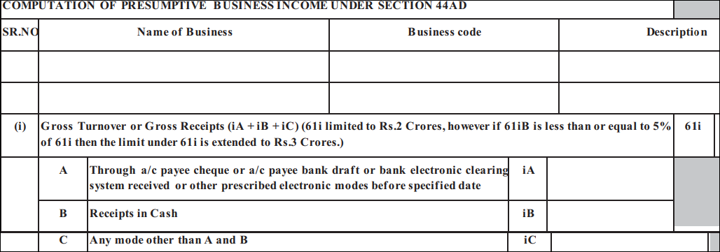
“Receipts in Cash” column added to claim enhanced turnover limit:
vkalra.com

Slide 34
Schedule 80U inserted for claiming deduction if the assessee is a person with a disability
In the form, a new 'Schedule 80U' has been introduced. This schedule is specifically designed to capture and detail deductions for individuals dealing with a disability. Taxpayers are now required to furnish the necessary information in this dedicated schedule, ensuring a more streamlined and accurate reporting process for deductions under Section 80U. The ‘Schedule 80U’ seeks the following details:
Nature of disability
Date of filing Form 10-IA
Acknowledgment number of the Form 10-IA
UDID number (If available)
.
vkalra.com

Slide 35
“New Schedule 80DD seeks details towards maintenance & medical treatment of the person with a disability:
In the earlier Income Tax Return (ITR) forms, taxpayers were instructed to declare the amount claimed as a deduction under Section 80DD in Schedule VI-A. However, the updated ITR forms 2 and 3 have introduced a new 'Schedule 80DD.' This dedicated schedule is designed to collect detailed information regarding the deduction claimed for maintenance, including medical treatment, of a dependent with a disability. Taxpayers are now required to provide specific details in this new schedule, facilitating a more comprehensive and accurate reporting process for deductions under Section 80DD.
These details comprise:
Nature of the disability
Type of dependent (spouse, son, daughter, father, mother, brother, sister or
member of the HUF)
PAN of the dependent
Aadhaar of the dependent
Date of filing and acknowledgement number of Form 10-IA
UDID Number (Uniqu7e disability id card)
vkalra.com

Slide 36
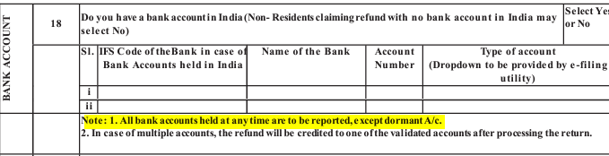
Reporting of all banks held at any time:
The ITR forms require information about the taxpayer’s bank accounts, including the selection of the specific account for receiving income tax refunds. In the new ITR forms 2, 3, 5 and 6, it is obligatory for the taxpayer to disclose all the bank accounts they have ever held, with the exception of dormant accounts.
vkalra.com

Slide 37
Other Common points.
Ensure to save ITR preview in folder.
Ensure to correctly report disallowance if any in Sch. Part A-OI.
Ensure to fill Sch. AL in case applicable.
Ensure to report minor income in Sch. SPI, if any.
Ensure to save all documents w.r.t the deduction claimed under chapter VI-A.
If any details reflecting in AIS/TIS or from 26AS which gets auto populated while downloading pre-fill is not matching with the actual data, kindly punch them manually in the ITR form.
vkalra.com

Slide 38
Other Common points.
Rebate of 25000 (for new regime) available for the ongoing AY if total income does not exceed 7.00 lacs. Further, Rebate under section 87A is subject to Marginal Relief for AY 2024-25: If the new income exceeds INR 7,00,000 but does not exceed INR 7,27,770, income tax on such income cannot exceed the amount by which the net income exceeds INR 7 lakhs
Ensure that TDS has been deducted at higher rate if the deductee has not furnished his return of income for the immediately preceding AY with the due date of filing of the return. The higher of the following rates of TDS will be levied on your income:
(i) TDS at twice the standard applicable
(ii) 5%
vkalra.com

Slide 39



Thank You
3rd Floor, MJ Tower,
55, Rajpur Road,
Dehradun - 248001
T: +91.135.2743283
+91.135.2747084
W: vkalra.com
Follow us on

